Slide 1
Version Control
Lecturer: Ngo Huy Bien
Software Engineering Department
Faculty of Information Technology
VNUHCM - University of Science
Ho Chi Minh City, Vietnam
nhbien@fit.hcmus.edu.vn

Slide 2

Objectives
To present what is version control.
To present why to use version control.
To present basic concepts of version control.
To use tools for automating version control tasks.
To integrate team’s work products.

Slide 3

Contents

Slide 4

References
Ben Collins-Sussman et al. (2011). Version Control with Subversion.
Alexandru Serban. Visual SourceSafe 2005: Software Configuration Management in Practice. Packt Publishing. 2007.
William Nagel. Subversion Version Control: Using The Subversion Version Control System in Development Projects. Prentice Hall PTR. 2005.
Jennifer Vesperman. Essential CVS. O'Reilly. 2006.

Slide 5
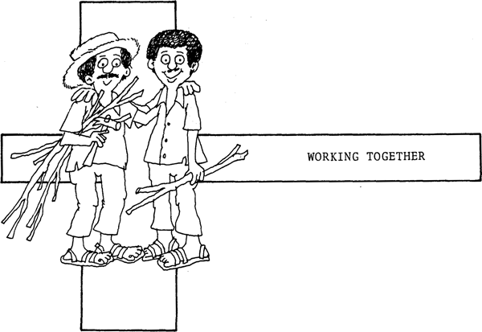
Working Together
Storage
Resource sharing
Independent and Simultaneous Development environment
Reverting resource
Merging code
Version control:
When did file X last change?
What changed in the file?
Who changed the file?
Where is file X?

Slide 6

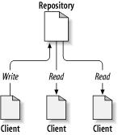
The Repository [1]
The repository stores information in the form of a filesystem tree—a typical hierarchy of files and directories.
Any number of clients connect to the repository, and then read or write to these files.
Typically server/client architecture.

Slide 7
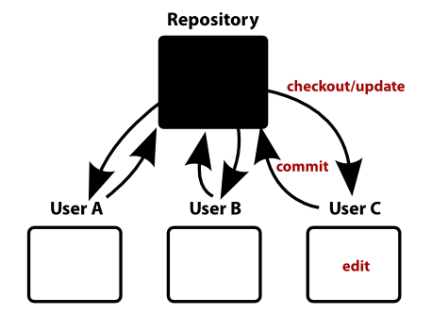
Working Copy [1]
The version control system manages the synchronization between repository and working copies
States:
Unchanged, and current
Locally changed, and current
Unchanged, and out-of-date
Locally changed, and out-of-date
Users work on a copy, the Working Copy

Slide 8
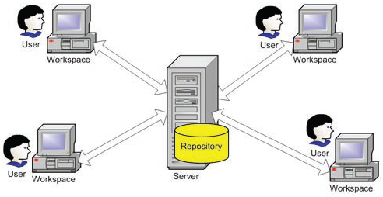
Workspaces [2]
An area where users can work separated from the repository and to isolate each user from the others.
Working folder
Working directory
Sandbox
View
Enlistment

Slide 9
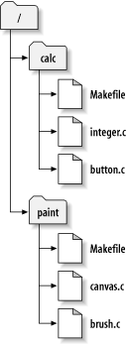
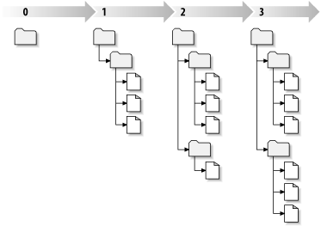
Revision [1]
Each time the repository accepts a commit, this creates a new state of the filesystem tree, called a revision.
Revision Numbers
Revision Keywords
HEAD
BASE, COMMITTED, PREV
Revision Dates
{2009-03-19}
{“2008-02-17 15:30”}
The repository's filesystem
Revisions
Mixed Revision Working Copies
Updates and Commits are Separate
calc/Makefile:4
integer.c:4
button.c:4
calc/Makefile:4
integer.c:4
button.c:5
calc/Makefile:6
integer.c:6
button.c:6
Global Revision Numbers

Slide 10
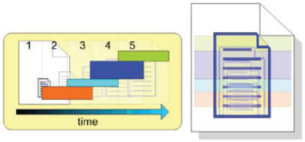
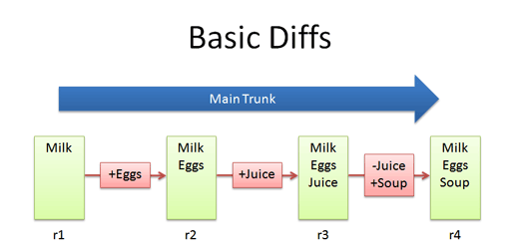
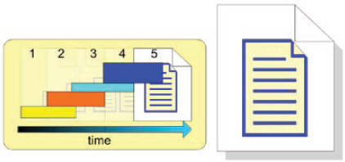
Deltas [2]
The difference between the two revisions is called a delta.
Forward Deltas
Reverse Deltas

Slide 11
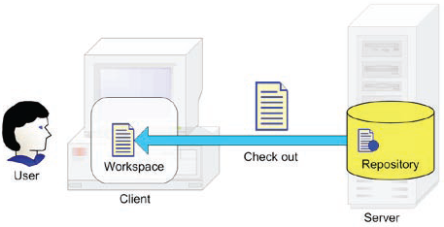
CheckOut/Update
To get a resource from the repository with the purpose of making changes to it
A patchfile is a special file that can be used by the patch utility to update a set of files from one revision to another.

Slide 12
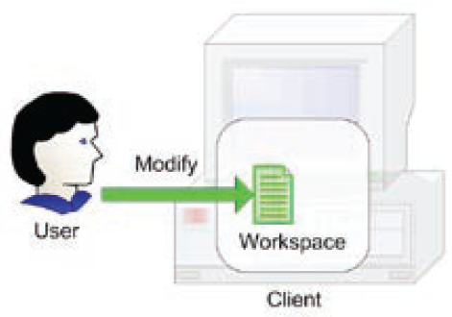
Modify/Edit
To make changes to the resources in our workspace.

Slide 13
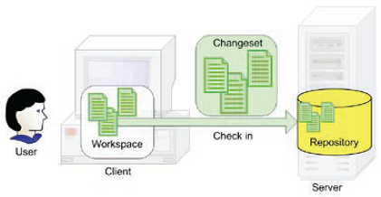
Check In/Commit
To save changes to the repository
Atomic commits ensures that while one person is committing changes to the repository, no one else can.
A hook is a place to hang a script, such that the script is run at a specific stage of the version control process perhaps before or after a change is committed, when a log message is stored, or when a file is checked out for exclusive development.

Slide 14
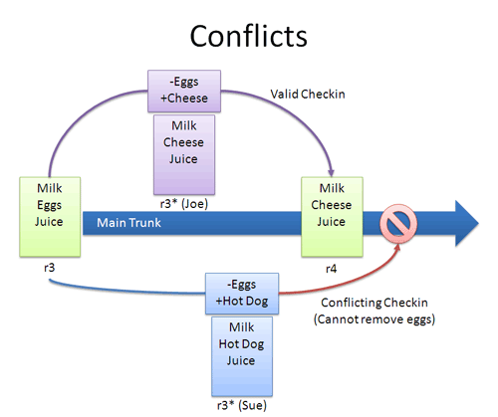
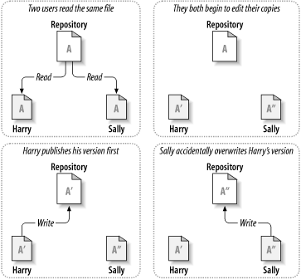
Conflict

Slide 15
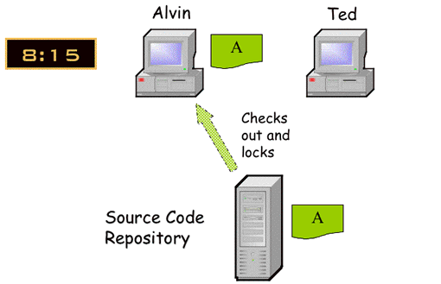
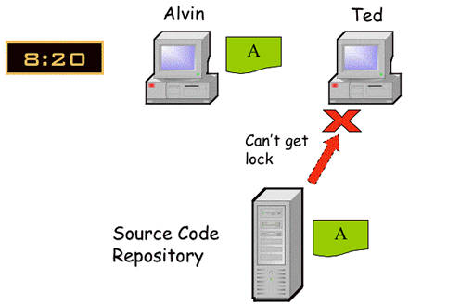
Lock – Modify – Unlock

Slide 16
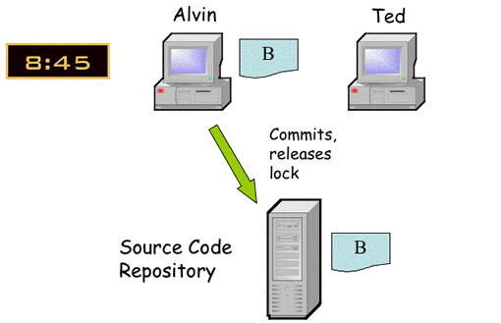
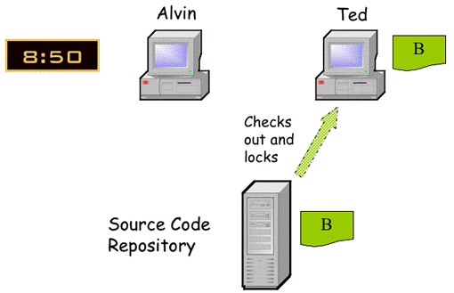
Lock – Modify – Unlock (cont.)

Slide 17






Copy – Modify – Merge
To combine changes of 2 working copies to one working copy
Automatic merge
Manual merge

Slide 18

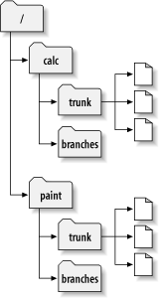
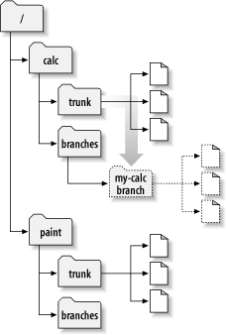
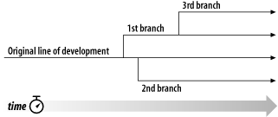
Branch
A codeline represents a project's development evolution across time, having a continuous history.
A branch is a line of development that exists independently of another line.
Starting repository layout
Repository with new copy

Slide 19
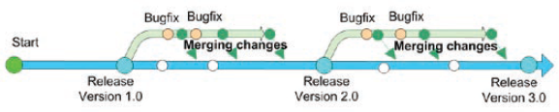
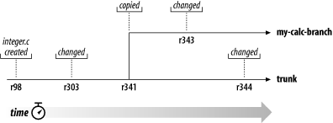
Merging Branches
To integrate changes performed in one branch into another branch.
The branching of one file's history

Slide 20
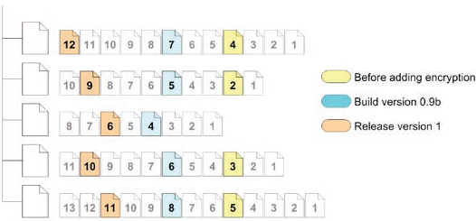
Tag/Label
A tag (label) is just a snapshot of a project in time.

Slide 21


Exclusive Development
The version control system permits only one user at a time to work on any individual file.

Slide 22
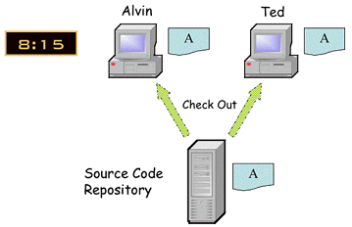
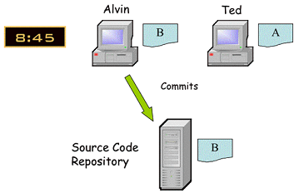
Simultaneous Development
Multiple users can work on the same file and the version control system attempts to merge the respective changes seamlessly.

Slide 23
Central Repository
Central repository – The historic data about project changes is stored in a single place.
Central Repository
User
User
User
User
Data export – An exported set of data should not contain administrative files or data for the version control system.

Slide 24
Distributed Repositories
Distributed Repositories – Each developer has a personal repository, and the repositories update from their peers.
Repository
Repository
Repository
User
User
User

Slide 25
Proxied Repositories
Proxied repositories – There is a central repository, which holds the changes data, and proxy repositories, which are used for read requests and which refer write requests to the central repository.
User
Central Repository
Proxy Repository
Proxy Repository
Proxy Repository
Proxy Repository
User
User
User

Slide 26
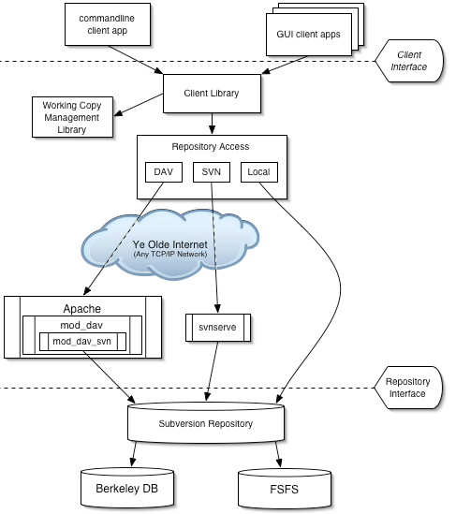
Remote Access to the Repository

Slide 27

Why Use Version Control?
Any version control is better than no version control.
File history maintenance.
Simultaneous working on file.
Distributed development.
Simultaneous development with branches.

Slide 28


Version Control Tools
https://subversion.apache.org/
https://tortoisesvn.net/
http://git-scm.com/
https://github.com/
https://bitbucket.org/

Slide 29
Other Tools
VSS (http://msdn.microsoft.com/en-us/vs2005/aa718670.aspx)
CVS (http://www.nongnu.org/cvs/)
Perforce (http://www.perforce.com/perforce/products.html)
BitKeeper (http://www.bitkeeper.com/Products.html)
Accurev (http://www.accurev.com/accurev.html)
ClearCase (http://www-306.ibm.com/software/awdtools/clearcase/)
CM Synergy (http://www.telelogic.com/corp/products/synergy/index.cfm)
StarTeam (http://www.borland.com/us/products/starteam/index.html)
MKS Integrity (http://www.mks.com/products/index.jsp)
Vault (http://www.sourcegear.com/vault/)

Slide 30

Thank You & See You Again

